Slide 1
Epigenetic regulation of environmental response in the Pacific oyster, Crassostrea gigas
Mackenzie Gavery
University of Washington, SAFS
Final Examination
June 4th, 2014
Notes:
Today, I’m going to be talking about ….

Slide 2
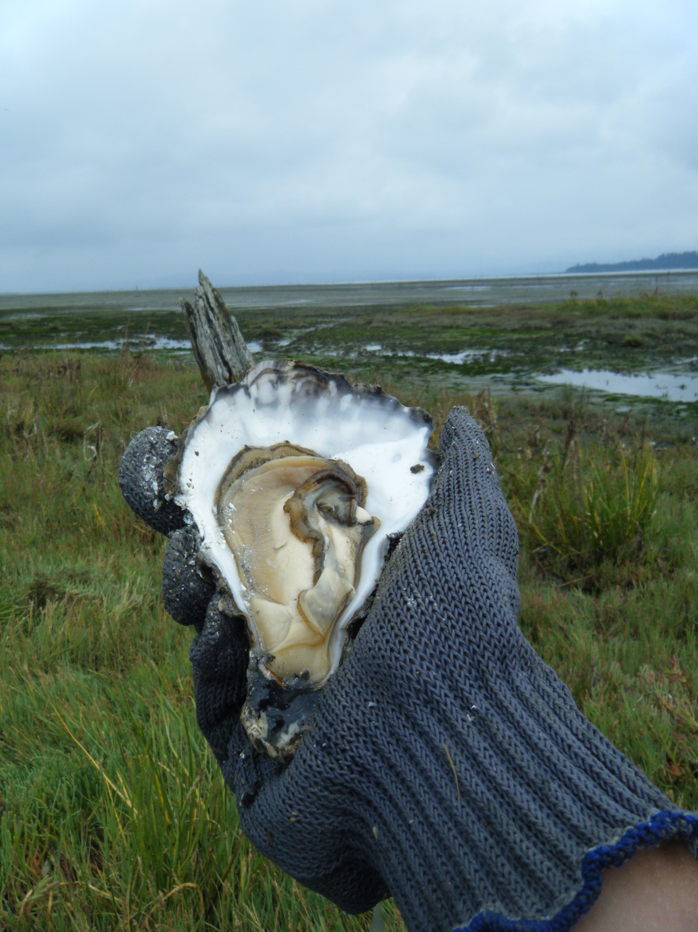
Outline
Background
Oysters
Epigenetics
DNA methylation in oysters
Characterization of DNA methylation
How do oysters use methylation to regulate their genome?
How does DNA methylation influence their ability to responds and adapt to the environment?
Notes:
Today I’m going to start with presenting some background about the biology of oysters and why they are an important species to study
Then I’ll give some background about epigenetics and specifically DNA methylation which is the focus of my research
Then I’ll be presenting the results of my dissertation in 3 parts
The first part includes a characterization of DNA methylation in oysters – this work represents the first full characterization of DNA methylation in a molluscan species
The second part uses various high throughput sequencing approaches to ask the question..
The final part … is a synthesis and uses the data from part 1 and 2 to ask the important question..

Slide 3
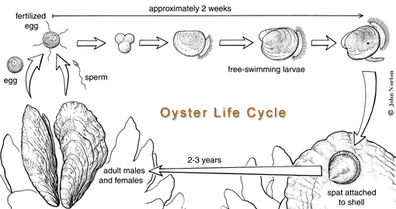
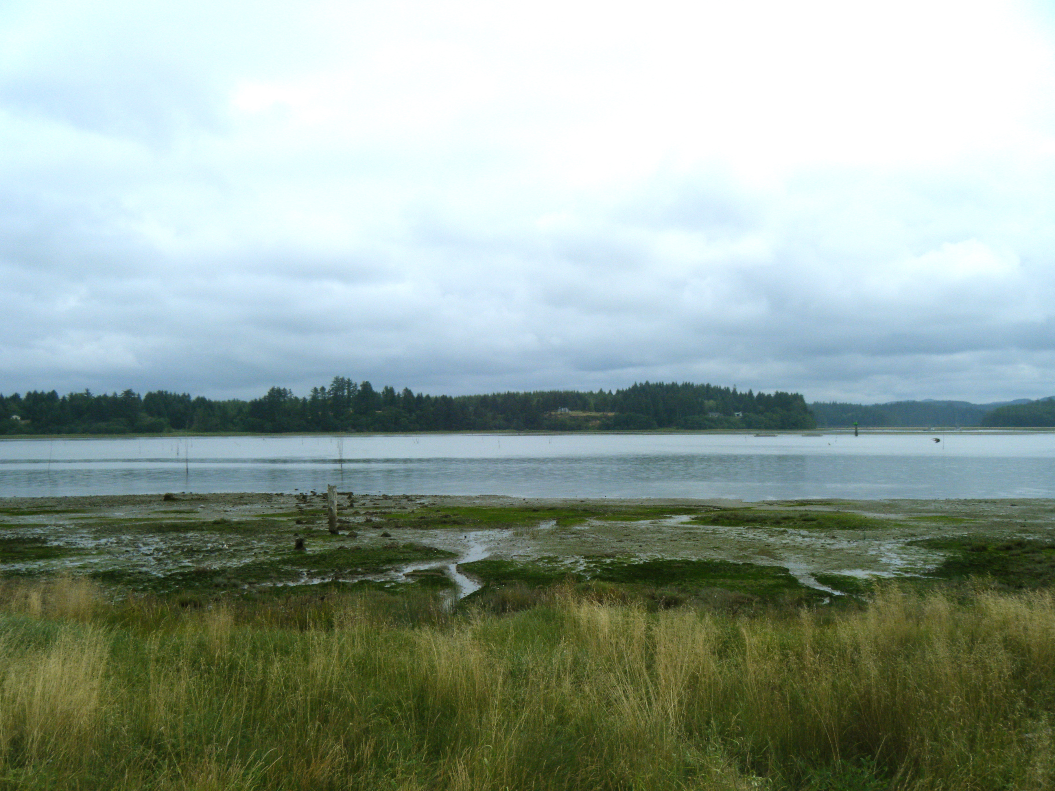
Oysters: Biology
free swimming larvae (2 weeks)
egg
sperm
2-3 years
juvenile
Notes:
Oysters are estuarine molluscs that live in lower intertidal areas,
They are broadcast spawners that produce planktonic larvae that settle out to into sessile filterfeeding adults
Because of this life cycle – oysters offer numerousecological benefits
First, Planktonic larvae are an important food source for other marine species
Second, Oyster reefs provide valuable habitat
Third, Filter feeding improves water quality

Slide 4
Oysters: Biology
disease
salinity
temperature
dessication
Notes:
Estuarine intertidal zones can be very challenging environments with daily changes in tides and seasonal changes in salinity and temperature.
Larval oysters are planktonic and can move with currents, but once the larvae settle in a particular environment they becomes immobile.
What this means from a biological perspective is that oysters need to be able to identify and respond quickly to environmental changes

Slide 5
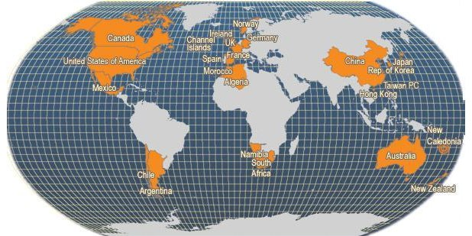
Oysters: Economic value
Major Producers of Crassostrea gigas
(FAO Fishery Statistics, 2006)
Notes:
It’s also important to note that oysters are delicious
Provide a sustainable source of protein and other nutrients
The species of oyster I study – crassostrea gigas – is cutlured worldwide
Because of this oyster production contributes to the economies of many countries – including the US.

Slide 6
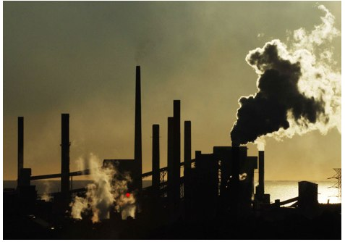
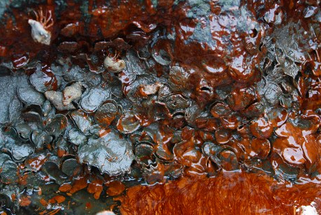
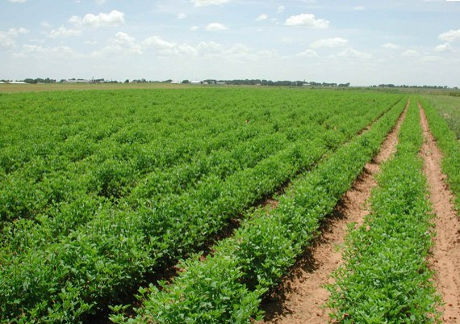
Oysters: Threats
Notes:
Oyster Also face a number of threats
from global climate change and it’s associated ocean acidification
To events such as oil spills and increased runoff which can contain numerous toxic compounds

Slide 7
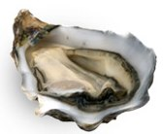
color
disease resistance
growth
TRAITS
temperature
pathogens
nutrition
GENES (DNA)
ENVIRONMENT
Notes:
And so it’s because they are so ecologically and economically valuable I think it’s important to understand the role of epigenetics in oysters…
in the past, we’ve typically considered 2 things influencing an organisms traits, genes and the environment..

Slide 8
color
disease resistance
growth
TRAITS
temperature
pathogens
nutrition
EPIGENOME
(DNA methylation)
GENES (DNA)
ENVIRONMENT
Notes:
But what we now know Is that DNA isn’t everything….an organism also has an epigenome. And that these epigenetic marks, (such as DNA methylation) are important in gene regulation – meaning they can they can also affect TRAITS

Slide 9
color
disease resistance
growth
TRAITS
temperature
pathogens
nutrition
EPIGENOME
(DNA methylation)
GENES (DNA)
ENVIRONMENT
Notes:
- and, unlike DNA, these epigenetic marks can be directly impacted by the environment – and in some cases these environmentally changes can be heritable over multiple generations, even after the environment stimulus has been removed
So by understanding epigenome we will have a more holisic understanding of how the oyster interacts with and responds to it’s environment.

Slide 10
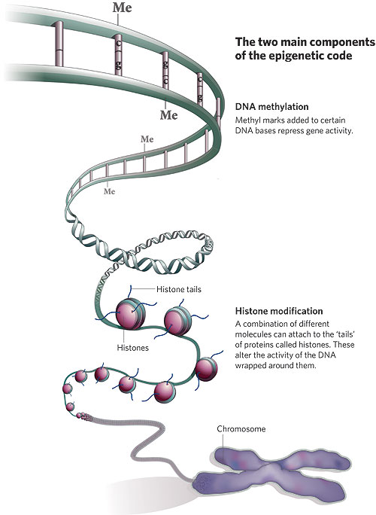
Epigenetics
Marks
CHROMATIN PACKAGING
Histone modifications
Acetylation
Methylation
DNA methylation
Notes:
Epigenetics refers to hertiable changes in phenotypes that are caused by mechanisms other than mutation to the DNA sequence
Two major epigenetic mechanisms are histone modifications and DNA methylation
Histones are that proteins that DNA winds around to form chromatin. Modifications of these proteins, including acetylation and methylation of histone tails, can cause changes in gene regulation.
DNA methylation is the most well studied epigenetic mark and also plays a significant role in gene regulation

Slide 11
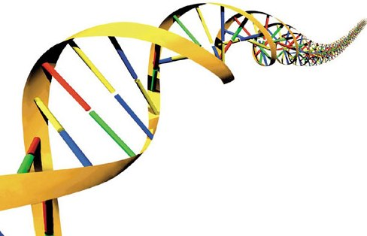
C
G
G
C
Me
Notes:
DNA methylation is an epigenetic mark which refers to the addition of a methyl group to a cytosine res in the DNA – in animals this occurs almost exclusively in this CG context where a cytosine is followed by a guanine.
DNA met has been well studied in mammals – where it’s known to play an important role in regulating gene expression
In the mammalian model you can think of DNA methylation as a kind of switch helping to inform the cells of when turning genes on or off.

Slide 12
TF
X
C
G
Gene A
G
C
Me
Notes:
Typically, the presence of DNA methylation is associated with transcriptional silencing – for example, methylation found in a promoter region can block TF binding preventing gene expression

Slide 13
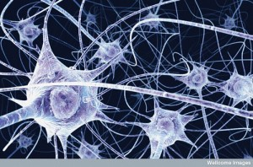
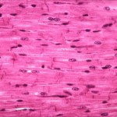
TF
X
C
G
Gene A
G
C
Me
Notes:
dna methylation has many important functions –
Including maintaining tissue differentiations – all of your cells contain same dna, yet your muscle cells look very different from your blood cells and this is controlled in part through DNA methylation

Slide 14
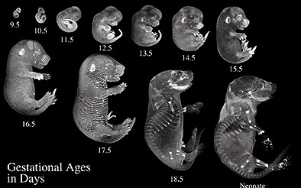
TF
X
C
G
Gene A
G
C
Me
Notes:
Dna methylation also important in regulating deveopmental processes

Slide 15
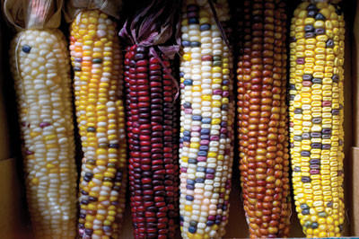
TF
X
C
G
Gene A
G
C
Me
Notes:
DNA methylation can provide stability to genomes by silencing portions of the genome that shouldn’t be expressed. For example transposable elements (jumping genes) are found in high numbers in plant genomes. A majority of the TE’s in plants are heavily methylated supressing the ability of these elements to be mobile. If these elements hop into a coding region of a gene that can affect phenotypes (such as the example of the different colored kernals in maize).
As I mentioned before, DNA methylation can also be influenced by environmental signals…

Slide 16
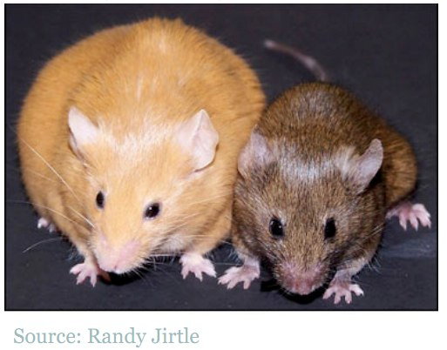
Nutrition and Toxin
Genetically identical female mice
Different DNA methylation status of the Agouti gene
Affected by toxins/diet
Notes:
And One of the best visual examples of the impact environment of DNA methylation is in the agouti sisters
These 2 female mice are genetically identical but they have different DNA methylation patterns giving rise to these very distinct phenotypes.
Researchers in the Jirtle lab used this phenotypic marker to show environmental factors could affect DNA methylation – they exposed pregnant mice to the endocrine disrupting compound bisphenol A and saw that her offspring showed a decrease in overall methylation of the promoter of the Agouti gene which resulted in a higher proportion of offsping having the yellow obese phenotype

Slide 17
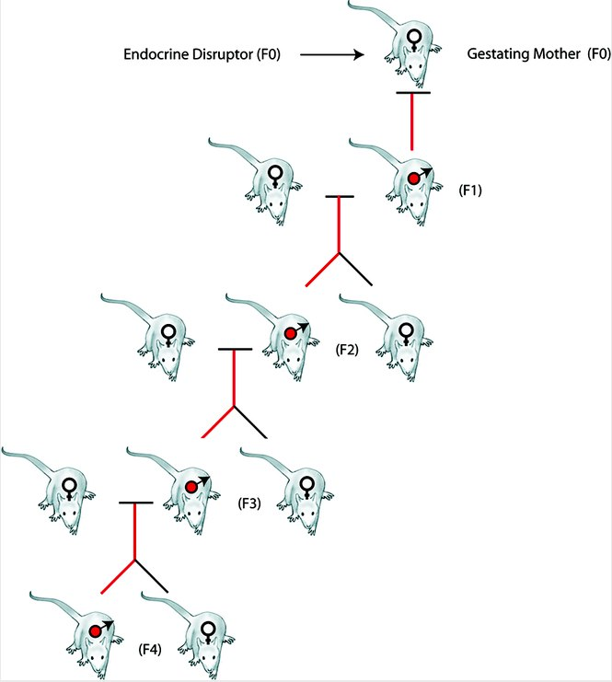
Transgenerational Epigenetics
(Skinner 2007)
Notes:
Although mammals undergo extensive epigenetic resetting between generations, certain DNA methylation marks can maintained and passed on to offspring
Research from the lab of Michael Skinner has shown that phenotypic changes associated with endocrine disruptor exposure can be transgenerationally inherited through disruptions to methylation in the male germline.
This type of research in transgenerational epigenetics not only has implications for transmission of environmentally induced disease states, but also has evolutionary implications since environmental “information” is being inherited through germline DNA methylation patterns

Slide 18
DNA methylation: invertebrates
Notes:
I’ve provided background now about what we know about DNA methylation
As I mentioned, a vast majority of this information comes from studies does in mammals and even plants however much less is known about the role of DNA methylation in invertebrates..

Slide 19
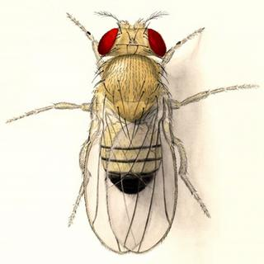
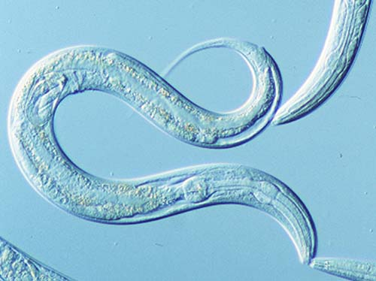
DNA methylation: invertebrates
Model invertebrates lack DNA methylation
Notes:
One of the reasons less is known is that our model inverts such as … essentially lack DNA methylation in their genome,

Slide 20
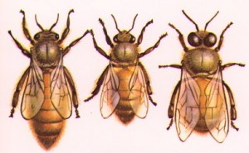
DNA methylation: invertebrates
Only handful of species have been studied
Intermediate level of methylation
Methylation is limited to gene bodies
Important regulatory functions in honey bees
(e.g. Kucharski et al., 2008; Elango et al., 2009; Lyko et al., 2010)
Notes:
However, more recently, it’s been shown that a number of invertebrate genomes do contain methylation – and that droso and c. elegans may be the exception rather than the rule
In general have a much lower level of dna meth than mammals - and when methylation is present it’s primarily located within gene bodies where it’s regulatory role is less clear
Nevertheless, in work that was being done when I started here at SAFS, researchers were showing that DNA methylation had important regulatory functions in honey bees
In honey bees genetically identical individuals can develop into queens or workerswith dramatically dfferent phenotypes in terms of reproductive status and longivity
If a larval bee is fed a substance called royal jelly – she will develop into a queen, while the rest will develop into workers
Kucharski in 2008 showed that if dna methylation was experimentally turned off in bees a majority of them developed into queens similar to what they would look like if they were fed royal jelly indicating that DNA methylation was a mechanism bees used to mediate the phenotypic response to an environmental signal – in this case, nutrition.
These papers were very influential to my research and I wanted to understand how DNA methyation influenced the capacity of the oyster to respond to it’s environmment…

Slide 21
Research Objectives
Characterization of DNA methylation in oysters
Do oysters use DNA methylation to regulate their genome?
How does DNA methylation influence their ability to respond and adapt to environment?
disease resistance
growth
TRAITS
temperature
pathogens
nutrition
EPIGENOME
(DNA methylation)
GENES
(DNA)
ENVIRONMENT
Notes:
So my research was aimed at characterizing and understanding this epigenetic mark in oysters
And my approach to this can be broken down into 3 general parts
The first was simply - ---,
The second question was do oyster use… we know that DNA methylation influences gene expression and genome stability in mammals – but because methylation patterns are so different in mammals and invertebrates – it may not be appropriate to assume that the mechanisms are conversed
And finally, the last questions I asked was, using what I’ve learned so far,..
No I would like to go through each of these parts in more detail

Slide 22
Part I.
Characterization of DNA methylation in oysters
Do oysters have DNA methylation?
Methylation sensitive restriction digests
Identification of DNA methyltransferases (DNMT)
Targeted bisulfite sequencing
Predicting DNA methylation using in silico analysis and verification using MBD-Seq
Notes:
Starting with the Characterization..
And to answer this question I took a few approaches –
The first important thing to do was to find out if oysters had dna methylation - this was a necessary first step since methylation is absent in some invertebrate genomes and there was nothing known about methylation in molluscs
the first was to measure dna mehtylation directly using targeted bisulfite sequencing
The second was to utilize a method that predicted dna methyion through an in silico analysis
And finally to verifcy the in silico analysis using an experimental approach called mBD_seq

Slide 23
Part I. Bisulfite sequencing
T
C
T
C
G
bisulfite
T
U
T
C
G
PCR
T
T
T
C
G
Notes:
The first approach I used is called bisulfite sequencing and this approach is the current gold standard for measuring dna methylation
For this method, genomic DNA is treated with sodium bisulfite
which converts unmethylated cytosines to uracil residues - however, methylated cytosines are protected from conversion and will remain as cytosines

Slide 24
Part I. Bisulfite sequencing
T
C
T
C
G
bisulfite
T
U
T
C
G
PCR
T
T
T
C
G
Notes:
Following PCR and sequencing an unmethylated cytosine will appear as a thymine when mapped back to the original reference sequence, whereas any cytosines remaining in sequence will represent sites that are methylated

Slide 25
Part I. Bisulfite sequencing
(Gavery & Roberts, 2010)
Notes:
Using this approach I was able to sequencing two small regions of oyster DNA
Within this region each CG dinucleotide is marked by a circle. An open circle indicates an unmehtylated CG and a closed circle indicates a methylated CG.
Each of the regions sequenced showed one methylated CG indicating that methylation was present at low levels

Slide 26
Part I.
Characterization of DNA methylation in oysters
Do oysters have DNA methylation?
Methylation sensitive restriction digests
Identification of DNA methyltransferases (DNMT)
Targeted bisulfite sequencing
Predicting DNA methylation using in silico analysis and verification using MBD-Seq
Notes:
The second approach…

Slide 27
Part I. in silico analysis
Principle:
Methylated cytosines are highly mutable
C → T
Methylated regions of DNA are depleted of CpG dinucleotides over evolutionary time (CpG to TpG)
m
CpG observed
CpG o/e
low = methylated
high = unmethylated
CpG expected
Notes:
The in silico approach uses an established method to predict methylation status of a gene using a ratio of observed to expected CpG dinucleotide frequencies
The principle behind this is that methylated cytosines are highly mutable and will spontaneiously deaminate to a thymine residue..
Therefore…. As you get these CpG to TpG conversions – the principle is that the remaining CGs in these depleted areas are methylated.
We can use this information in order to predict the methylation status based on the ratio of observed to expected CpG dinucleotides..
Expected number of CpG is based on GC content and length of the sequence
The observed number is actual number of CpGs in a give sequence
Therefore a low CpG ratio indicates a densly methylated gene, that has been depleted of CpG
Whereas a high ratio (approaching 1) indicates a gene with no methylation
Using this approach we calc Cpg ratio for 10,000 oyster genes in a publicly available expressed sequence tag database
Because these genes were annotated we were able to cluster them by their biological function according to their gene ontology terms.

Slide 28
Part I. in silico analysis
Gavery & Roberts, 2010
Notes:
And here are the results of this analysis – showing mean CpG plus or minus 1 SE for 14 functionally distinct catagories of genes

Slide 29
Part I. in silico analysis
=methylated CpG
‘inducible’
‘housekeeping’
Gavery & Roberts, 2010
Notes:
and what was really striking about this are the categories of genes that are at the two extemes of this range of predicted methylation status
The catagories predicted to have the highest amount of methylation are all involved in general housekeeping functions – classes such as….
At the other extreme, the catagories predicted to be have the least methylation– including inducible classes of genes, so cell adhesion…., genes we typically associated with environmental response in oysters - for example genes in immunity and stress response
Here was our first evidence that DNA methylation played a regulatory role in oysters because functionally distinct classes of genes were showing different levels of DNA methylation – but we wanted to verify these results using an experimental approach..

Slide 30
Part I.
MBD-Seq: Methyl-binding domain (MBD) isolated genome sequencing

Slide 31
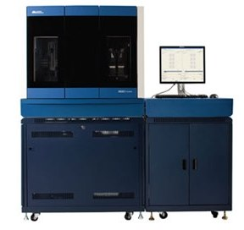
Part I.
MBD-Seq: Methyl-binding domain (MBD) isolated genome sequencing
MBD
Y
MBD
Y
MBD
Y
Notes:
MBD-seq –uses the affinity of a methyl binding domain protein separate out the methylated portion of the genome –once separated, The methylated fraction of the genome can then be analyzed by generating a DNA library and performing high throughput sequencing
Then in order to identify the genes present in the methylated fraction the reads must be mapped back to known reference sequences
In this case we mapped the read back to the same ESTs used for the in silico analysis - so that we could perform a similar functional clustering

Slide 32
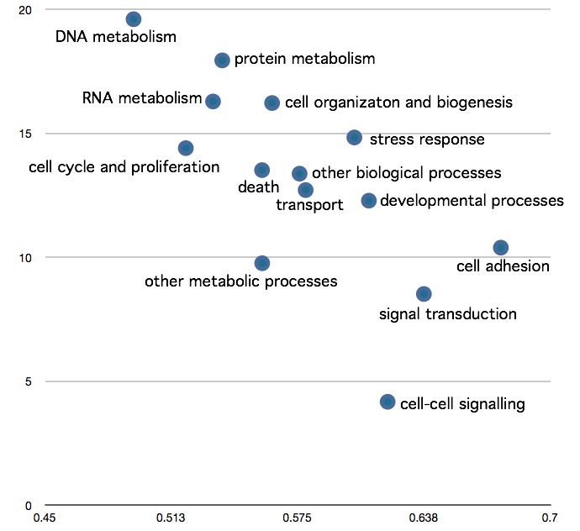
Part I. MBD-Seq
CpG O/E
(Gavery & Roberts, 2010)
Predicted degree of DNA methylation
Notes:
Here are the results showing the relationship between the silico analysis and the experimental MBD analysis
For orientation, I would first like to direct your attention the x-axis which is the CpGO/E from the original in silico analysis

Slide 33
Part I. MBD-Seq
Enrichment level in MBD library
(Roberts & Gavery, 2011)
Measured degree of DNA methylation
CpG O/E
(Gavery & Roberts, 2010)
Predicted degree of DNA methylation
Notes:
On the y-axis is a normalized enrichment value based on MBD-seq analysis.
here, the highest enrichment value would indicate categories that are the most overrepresented in the methylated fraction of the genome.
These results are consistent with the in silico analysis

Slide 34
Part I. MBD-Seq
Enrichment level in MBD library
(Roberts & Gavery, 2011)
Measured degree of DNA methylation
CpG O/E
(Gavery & Roberts, 2010)
Predicted degree of DNA methylation
Notes:
Where the categories of genes most overrepresented in the methyated fraction were ubiquitously expressed core genes – consistent with in silico analysis

Slide 35
Part I. MBD-Seq
Enrichment level in MBD library
(Roberts & Gavery, 2011)
Measured degree of DNA methylation
CpG O/E
(Gavery & Roberts, 2010)
Predicted degree of DNA methylation
Notes:
And also consistent with in silico, genes involved in …were the least represented in the methylated fraction of the genome.

Slide 36
Part I. MBD-Seq
Enrichment level in MBD library
(Roberts & Gavery, 2011)
Measured degree of DNA methylation
CpG O/E
(Gavery & Roberts, 2010)
Predicted degree of DNA methylation
Notes:
And what we’ve been able to show, through both in silico and experimental analysis is – that genes with differing regulatory requirements have diff levels

Slide 37
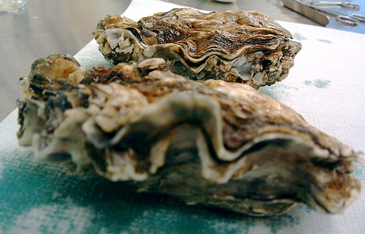
Part I. Summary
The oyster genome is methylated
Genes with differing regulatory requirements have different levels of DNA methylation
‘housekeeping’ ubiquitously expressed = methylated
‘inducible genes’ = unmethylated
Notes:
…
And we have the first evidence that DNA methylation plays a regulatory role in oysters because we see that gene with …..
But there is still a major question here – and that is we are talking about methylation within gene bodies and it’s not clear how this type of methylation regulates gene expression

Slide 38
TF
X
Gene A
Notes:
If you remember from the introductory stlide r I mentioned that methylation is typically associated with gene silencing – if the promoter of a gene is methylated, it can prevent gene expression

Slide 39
VERTEBRATE
TF
X
Gene A
Notes:
But again, when we talk about this we’re really talking about the vertebrate model..

Slide 40
INVERTEBRATE
VERTEBRATE
TF
X
Gene A
Gene A
Notes:
And what we are seeing with this first investigation in oysters, and also from other invertebrates such as honey bees is that…

Slide 41
INVERTEBRATE
VERTEBRATE
TF
X
Gene A
Gene A
Notes:
A majority of DNA methylation is located within gene bodies,

Slide 42
INVERTEBRATE
VERTEBRATE
?
TF
X
Gene A
Gene A
Notes:
…and it’s less clear how this type of methylation can regulate genes..

Slide 43
INVERTEBRATE
VERTEBRATE
?
TF
X
Gene A
Gene A
Notes:
What we do know is that if we
To paint the whole picture, Vertebrates have a lot of gene body methylation too.

Slide 44
INVERTEBRATE
VERTEBRATE
?
TF
X
Gene A
Gene A
Ancestral pattern
Notes:
What is emerging is that gene body methylation is the ancestral pattern
So the invertebrate pattern can serve as a simplified model to understand what gene body methylation may be doing in all taxa

Slide 45
INVERTEBRATE
VERTEBRATE
?
TF
X
Gene A
Gene A
Ancestral pattern
Regulatory function
Notes:
And from what we’ve seen in oysters so far is that this type of methylation likely has regulatory function, but we need more information in order to understand it better.
This leads to the second major question of my research is is

Slide 46
Part II.
How do oysters use DNA methylation to regulate their genome?
How is methylation distributed in the oyster genome?
What are the relationships between DNA methylation and gene expression?
Notes:
Which is how do…
More specifically I wanted to know how methylation was distributed was it only found in genes? If so was it in exons or introns or if it was also found in other regions?
I also wanted to look more closely at the relationships between DNA methylation and gene expression patterns to try to understand this..

Slide 47
Part II.
Approach
High-throughput bisulfite sequencing
genomic DNA
Notes:
To answer these questions We used htbs to analyze dna methylation in pooled gill tissue..
For this method, we prepare a genomic dna library for gill tissue, but prior to sequencing we treat the dna with sodium bisulfite as I described earlier and this allows us

Slide 48
Part II.
Approach
High-throughput bisulfite sequencing
genomic DNA
Notes:
To quantitatively “see” where the metylation is when the reads are mapped back to the genome

Slide 49
Part II.
Approach
High-throughput bisulfite sequencing
Gene expression: RNA-Seq analysis
genomic DNA
Notes:
In addition to generating full methylome,
Also performed RNA-Seq analysis of the same tissue – to look at relationships between DNA methylation and gene expression
One tool that also great facilitated this research was the release of the draft oyster genome in 2012

Slide 50
Part II.
Gill tissue: > 2.5 million CG dinucleotides
Notes:
Doing this analysis we have quanitative methylation data for over 2.5k CG sites throughout the genome
..and one way we could look at how the methylation was distributed is by using genome visualization tools

Slide 51
Part II.
0bp
200,000bp
CG
genes
exons
ex
%methylation
100%
0%
scaffold 86
(Galaxy Trackster)
Notes:
This is an snapshot of a visualizion done on the Galaxy showing a 200kb region of the oyster genome
The first track shows all the CG loci, these are all the potentially methylatedable sites
The next track shows location of genes, and below that the exons
The final track is showing Quantitive methylatio data:
Where each bar represents % methylation (between 0 -100%) of a particular CG locus
Now by scrolling through these different scaffolds we begin to see certain patterns..

Slide 52
Part II.
0bp
200,000bp
CG
genes
exons
ex
%methylation
100%
0%
scaffold 86
(Galaxy Trackster)
Notes:
Some genes are heavily methylated

Slide 53
Part II.
0bp
200,000bp
CG
genes
exons
ex
%methylation
100%
0%
scaffold 86
(Galaxy Trackster)
Notes:
And adjacent genes that show little to no methylation

Slide 54
Part II.
0bp
200,000bp
CG
genes
exons
ex
%methylation
100%
0%
scaffold 86
(Galaxy Trackster)
Notes:
And now, with the release of the genome – we can see for the first time that DNA methylation is present in intergenic regions.

Slide 55
Part II.
Distribution in genomic elements
Notes:
SO to summarize where the methylated cytosines were distributed in the gill tissue

Slide 56
Part II.
Distribution in genomic elements
Notes:
70% of the methylation was in regions in gene bodies,
24% in exons, another 45% in introns (one interesting thing here is that oysters have a comparatively high amount of methylaiton in introns compared to other invertebrates)
4% in putative promoters
5% in TE – but as a whole, TEs are not methylated in the gill tissue and this is in contrast to vertebrates and plants DNA meth used to silence Tes
22% he rest of the methylation was found in unannotated regions outside of genes.

Slide 57
Part II.
Relationship with expression
Notes:
We were also Interested in using this data to identify relationship between gene body methylation and gene expression
following on our previous findings, if methylation in gene bodies is important for regulation we would expect to see a relationship between methylation and expression

Slide 58
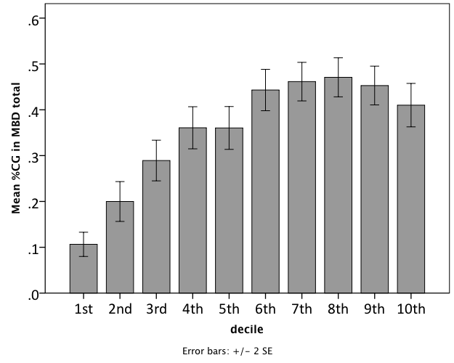
Part II.
Relationship with expression
DNA methylation/gene
Gene expression (Deciles)
Notes:
For this analysis, we used our corresponding RNA seq data and gene expression values were dividied 10 groups - those genes showing lowest expression in gill are in decile 1 and those with the highest expression are in decile 10.
Then we calculated and average % methylation for genes within each decile
We found that genes with the lowest expression in the gill tissue have significantly less DNA methylation than genes that are more abundantly expressed
What’s interesting, is that DNA methylaiton is typically associated with transcriptional silencing
– and what we are seeing with this analysis is that methylation within gene bodies is associated with transcriptional activity
--and this pattern is consistent with what is being reported in vertebrates.
So these data agaree our previous findings that gene body methylation is important in C.gigas

Slide 59
Part II.
Relationships with other gene specific attributes?
Notes:
Another way infer function of gene body methylation, was to explore how methylation co-varied with other gene-specific attributes

Slide 60
Part II.
Relationships with other gene specific attributes?
Spatial
e.g. number of exons, length of mRNA
Gene expression (Zhang et al 2012):
Mean expression level across 9 tissues
Variation in expression between tissues (%CV)
Notes:
The attributes we looked at included spatial variables, such as number of exons and gene length
We also looked at additional variables related to gene expression. For this analysis we used RNA-Seq dataset from Zhang et al where they reported gene expression for 9 different oyster tissues – we looked at the mean expression level across all tissues and also the variation in expression between tissues as a coefficient of variation or %CV
Because we wanted to look at how these variables related to methylation as well as each other, we used a multivariate approach called principal component analysis or PCA

Slide 61
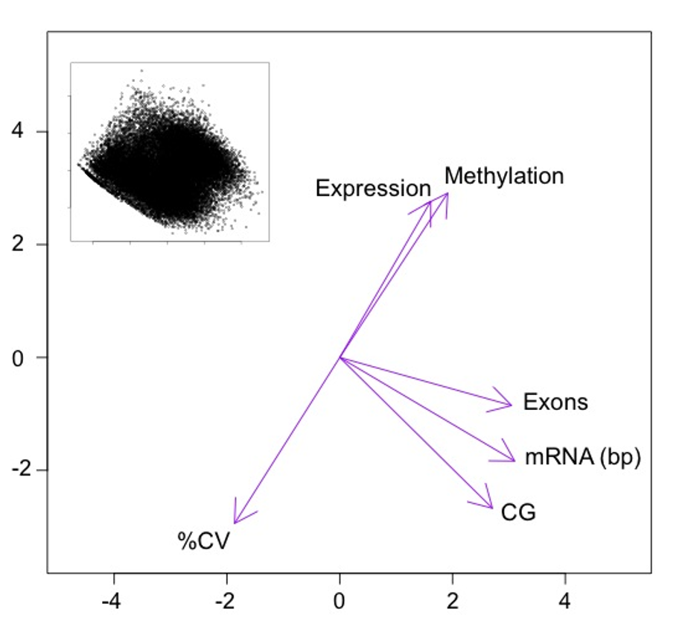
Part II.
PC2 (26.1%)
PC1 (50.2%)
Notes:
For this analysis we’re not really interested in the actual location of the 28k oyster genes which are shown in the inset, but instead we trying to identify those most important gradients driving the variation among the genes – and these are indicated by the direction and magnitude of the purple arrows
For example we see that the spatial variables, such as number of exons and gene length and number of CG are primarily driving the variation along the first principal compenent

Slide 62
Part II.
PC2 (26.1%)
PC1 (50.2%)
Notes:
We see DNA methylation driving the variation along the second principle component - additionally, we see gene expression describing the variation along the exact same direction – so genes in this area show high methylation and also show highly expressed–this is agreement with the data I just showed you from gill tissue
What I think is really interesting is that %CV between tissues describes the variation along the same gradient but in the opposite direction. Indicating that genes with low methylation also show tissue specific expression patterns

Slide 63
Summary
Notes:
So to summarize these data from the first two parts..

Slide 64
Summary
methylated
unmethylated
Notes:
We find that gene body methylation is important in oysters – and we’ve shown that there are differences between methylated and unmethylated genes and

Slide 65
Summary
methylated
unmethylated
Gene function:
Notes:
The first difference we were able to show is that genes with differing regulatory requirements had different amounts of dna methylation

Slide 66
Summary
methylated
unmethylated
Gene function:
housekeeping
inducible
Notes:
Specifically that methylated genes tended to be involved in housekeeping functions, whereas genes with inducible functions showed less methylation

Slide 67
Summary
methylated
unmethylated
Gene function:
housekeeping
inducible
Expression:
Notes:
Next we examined relationships between gene body methylation and expression where…

Slide 68
Summary
methylated
unmethylated
Gene function:
housekeeping
inducible
Expression:
high
low
Notes:
We saw that Genes with the highest expression were heavily methyalted where genes that were expressed less had lower methylation

Slide 69
Summary
methylated
unmethylated
Gene function:
housekeeping
inducible
Expression:
high
low
Tissue specific expression:
Notes:
Finally we uncovered and interesting relationship between DNA methylation and the tissue-specific expression of genes

Slide 70
Summary
methylated
unmethylated
Gene function:
housekeeping
inducible
Expression:
high
low
Tissue specific expression:
conserved
variable
Notes:
What we found was the genes with conserved expression across all tissue types tended to be more methylated than those with a tissue specific expression pattern
So by Summarizing this data, we can start to explore possible mechanisms of regulation
For example it’s possible that the reason highly expressed, housekeeping genes are heavily methylated is that it allows for efficient transcription of these core genes- and reduces transcriptional noise, by preventing initiation of transcription outside of traditional start sites.
While the lack of methylation in the inducible genes may promote variation in expression
..and this type of transcriptional variation could be beneficial in organisms like the oyster that live in highly fluctuating environments

Slide 71
Part III:
How does DNA methylation influence their ability to respond and adapt to environment?
Summary of DNA methylation in oysters
Propose a model for how oysters may be using the DNA methylation system to promote variation
Notes:
This leads me to the final question, which is…
To answer this I’d like to first summarize what we’ve learned so far about DNA methylation in oysters
Based on our findings and the findings of others

Slide 72
TF
X
C
G
Gene A
G
C
Me
Notes:
If we go back to the introductory slide about the functions of DNA methylation we can see how far we’ve come in understanding how this mechanism may be working in oysters

Slide 73
TF
X
C
G
Gene A
G
C
Me
16% CpG
Notes:
For example, using high-throughput bisulfite sequencing we were able to show that about 16% of the CpG dinucleotides are methylated in oyster gill tissue.
This is much lower than what we see for vertebrates where 70-80% of the CGs are mehtylated, but it is consistent with what is being reported in other invertebrates
In vertebrates, DNA methylation is known to be associated with gene silencing when it’s found in the promoters of genes..

Slide 74
C
G
G
C
Me
16% CpG
Notes:
Unlike vertebrates,

Slide 75
?
C
G
Gene A
G
C
Me
16% CpG
Notes:
We’ve shown that DNA methylation is much more promintent in gene bodies, where it’s associated with gene activity
In vertebrates, DNA mehtylation is associated with tissue-specific gene expression and developmental processes.
It’s still unclear if DNA methylation is associated with maintaining tissue specificity in invertebrates, but recent research efforts have investigated the role of DNA methylation in oysters during development

Slide 76
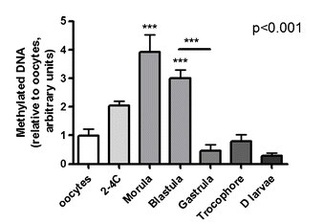
?
C
G
Gene A
G
C
Me
16% CpG
(Riviere et al., 2013)
Notes:
Last year, Riviere et al published a study showing that total DNA methylation changes during oyster larval development. With increasing DNA methylation during the 2-4 cell stage, morula and bastula and decreasing in later larval stages. Using this data as well as other supporting evidence – they suggest that proper dna mehtylation is crucial for larval development in oysters.
Finally I mentioned that both plants and vertebrates use DNA methylation to silence transposable elements

Slide 77
?
C
G
Gene A
G
C
Me
16% CpG
(Riviere et al., 2013)
Notes:
When we look at oysters however, the TEs are not heavilyt methylated. This finding is consistent with what has been reported in other invertebrates such as honey bees..and ants??
This could indicate that Tes are being silenced by another epigenetic mechanism
or that oysters exercise less regulatory control of Tes - In fact, oyster genome was released by Zhang et al in 2012, the authors noted that Tes were in fact transcriptionally active in the oyster genome..
So to summarize what we’ve learned, it appears that oysters ARE using DNA methylation to regulate portions of their genome. They show some similarieis in patterns to higher vertebrates, such as the presence of gene body methylation and changes over development, but they also show some unique proporties – including and lack of TE methylation…

Slide 78
Model
Notes:
So now I would like to present a model to illustrate how the patterns of DNA methylation that we’re observing in oysters may be beneficial to this species…

Slide 79
Model
The distribution of DNA methylation may function to promote variation in environmental response genes
Planktonic larvae
Sessile
Variable environments
Notes:
What I am proposing here is that oysters may be using the DNA methylation system in order to keep tight regulatory control over those genes core to survival, while promoting the opportunity for variation in environmental response genes
This type of variation would be beneficial for organisms like oysters which produce100s of thousands of planktonic larvae which drift with the current before settling out in highly fluctuating environments.

Slide 80
Model
methylated
unmethylated
Notes:
This is a simplified illustration of the model:
In this figure – the two classes of genes, methylated and unmethylated, are represented in the boxes, with individual exons marked as different colors
Below the genes, depicted by the thin lines are the possible mRNA transcripts derived from these different methylation states

Slide 81
Model
methylated
unmethylated
housekeeping
Notes:
On the left, you can see the heavily methylated housekeeping genes
Here the model is showing that methylation in these core genes supports efficient, conventional transcription

Slide 82
Model
methylated
unmethylated
housekeeping
inducible
Notes:
On the right, the the lack of methylation in the inducible genes may promote variation in expression through alternative splicing mechanisms
Alternative splicing is a process during gene expression where 1 gene can give rise to multiple proteins
The relationship between methylation and alternative splicing has been recently investigated in honey bees, for example a recent study by Li-and Byarlay in 2013 – showed when DNA methylation was knocked down in honeybees , alternative splicing increased.
The fact that we see similar patterns in methylation between these species suggests that oysters may be using similar mechanisms to increase the diversity of proteins
In this model, the absence of methylation could give rise to alternative splicing events through either random or targeted variation
Random variation could increase variety of all splice variants produced
While targeted variation while could support the generations of a specific isoform

Slide 83
disease
salinity
temperature
dessication
Notes:
Now, let’s put this model in the context of a sessile oyster that has to cope with harsh and dynamically changing environments
One very important way that oyster populations mitigate these challenging environments is through genetic variation

Slide 84
disease
salinity
temperature
dessication
Notes:
Genetic variation that results in phenotypic variation – indicated here by the various colors of oysters – increases the probability that or more genotypes will be adapted for a particular set of environmental conditions
Epigenetics by no means replaces the importance of genetic variation – but what this model shows is that oysters may be using the DNA methylation system as a tool to enhance this variation

Slide 85
unmethylated
inducible
disease
salinity
temperature
dessication
Notes:
Following the model: the lack of DNA methylation in the inducible, environmental response genes, could lead to variation in a random manner -
*****So that all individuals are making a variety of proteins – this variety could help oysters survive across a wider range of environments

Slide 86
unmethylated
inducible
disease
salinity
temperature
dessication
Notes:
The other possibility in this model – and these two scenarios are not mutually exclusive - Is that the lack of methylation in the inducible could lead to variation in a targeted manner

Slide 87
unmethylated
inducible
disease
salinity
temperature
dessication
Notes:
In this scenario environmental cues, such as exposure to high temperature, could induce transient methylation events, resulting in the production of specific isoforms

Slide 88
unmethylated
inducible
disease
salinity
temperature
dessication
Notes:
and ultimately specific phenotypes that are more optimally suited to high termperature
In support of this, a number of studies performed in plants show that specific genes show methylation changes in response to different types of stress

Slide 89
unmethylated
inducible
disease
salinity
temperature
dessication
Notes:
In both of these scenarios, whether the transcriptional response is random or targeted, the methylation patterns are increasing the robustness of a population by contributing to phenotypic plasticity

Slide 90
Model
methylated
unmethylated
housekeeping
inducible
Notes:
If we go back now to our model– it is also possible that the DNA methylation may also be functioning to enhance genetic variation

Slide 91
Model
TE
methylated
unmethylated
TE
housekeeping
inducible
Notes:
And we see this in the lack of repressive methylation of transposable elements.
TE mobility can cause rearrangements in the genome create new genetic variation

Slide 92
disease
salinity
temperature
dessication
Notes:
If we think about what this means for oyster populations, it’s possible that even in the case of a severe environmental event like a disease outbreak

Slide 93
disease
salinity
temperature
dessication
Notes:
Which can exert strong selection pressure for a specific phenotype
Populations may still have the ability to generate new genetic variation

Slide 94
TE
disease
TE
salinity
temperature
dessication
TE
Notes:
Through the activity of transposable elements in the genome

Slide 95
Next steps
Test methylation dynamics in response to environment
Investigate if DNA methylation patterns are heritable over multiple generations
Explore the role of TEs in shaping genetic variation
disease resistance
growth
TRAITS
temperature
pathogens
nutrition
EPIGENOME
(DNA methylation)
GENES
(DNA)
ENVIRONMENT
Notes:
In terms of verifying the proposed model,
it will be important to test the methylation dynamics in patterns in response to various environments
It will also be important to… If methylation patterns are heritable it would have significant implicaitons. On one hand, this has the potential to be adaptive if offspring are likely to encounter the same environments as their parents, however, it could also bedetrimental because even short term exposures to toxins may have long term effects on populations
Finally, one thing I am particularly interested in after doing this research is further exploring the role of Tes in shaping genetic variation in oysters

Slide 96
Conclusions
disease resistance
growth
TRAITS
temperature
pathogens
nutrition
EPIGENOME
(DNA methylation)
GENES
(DNA)
ENVIRONMENT
Notes:
This is the first time epigenetics has been examined thoroughly in any molluscan species – what this research shows is that DNA methylation is involved in gene regulation in oysters and is very likely to be involved in environmental response..

Slide 97
Conclusions
This research has significant implications for the way we study aquaculture.
disease resistance
growth
TRAITS
temperature
pathogens
nutrition
EPIGENOME
(DNA methylation)
GENES
(DNA)
ENVIRONMENT
Notes:
As a results this research has significant implications for the way we study aquaculture
Phenotypic plasticity is generally not desired in aquaculture settings. If we genetically select an oyster line because it has good disease resistance or high growth we want it to be disease resistant and grow well in all locations we put it in. If the oyster DNA methylation system is predisposed toward plasticity and variation in different environments it could mean that universal oyster lines will be quite challenging to produce.

Slide 98
Conclusions
This research has significant implications for the way we study aquaculture.
This research challenges the way we think about selection and adaptation
disease resistance
growth
TRAITS
temperature
pathogens
nutrition
EPIGENOME
(DNA methylation)
GENES
(DNA)
ENVIRONMENT
Notes:
And finally, This research..
One important area of research right now is in trying to understand how organisms like oysters will respond to climate change and acidification –if this model holds true it may indicate that oysters are epigenetically equipped, in terms of transcriptional and genomic plasticity, to handle more environmental change than what we may think based on genetics alone

Slide 99
Acknowledgements
Roberts Lab:
Sam White
Claire Olson
Emma Timmins-Schiffman
Brent Vadopalas
Jake Heare
Taylor Shellfish:
Joth Davis
Molly Jackson
eScience Institute :
Dan Halperin
Bill Howe
UW Statistics
Dustin Lennon
Committee:
Steven Roberts
Graham Young
Carolyn Friedman
Joth Davis
Charles Laird
Notes:
I would like to thank all the members of the Roberts lab
Who have contributed to this research through field and lab support and providing great feedback on manuscripts and talks
I would like to thank Joth Davis and Taylor Shellfish for providing me with all of the oysters used in these studies
Dan Halpersin and Bill how from escience for help with data management of the ht data Dustin Lennon for his help with the statistical analysis of the in silico data
I would like to espicially thank the members of my committee, my advisor, …

Slide 100
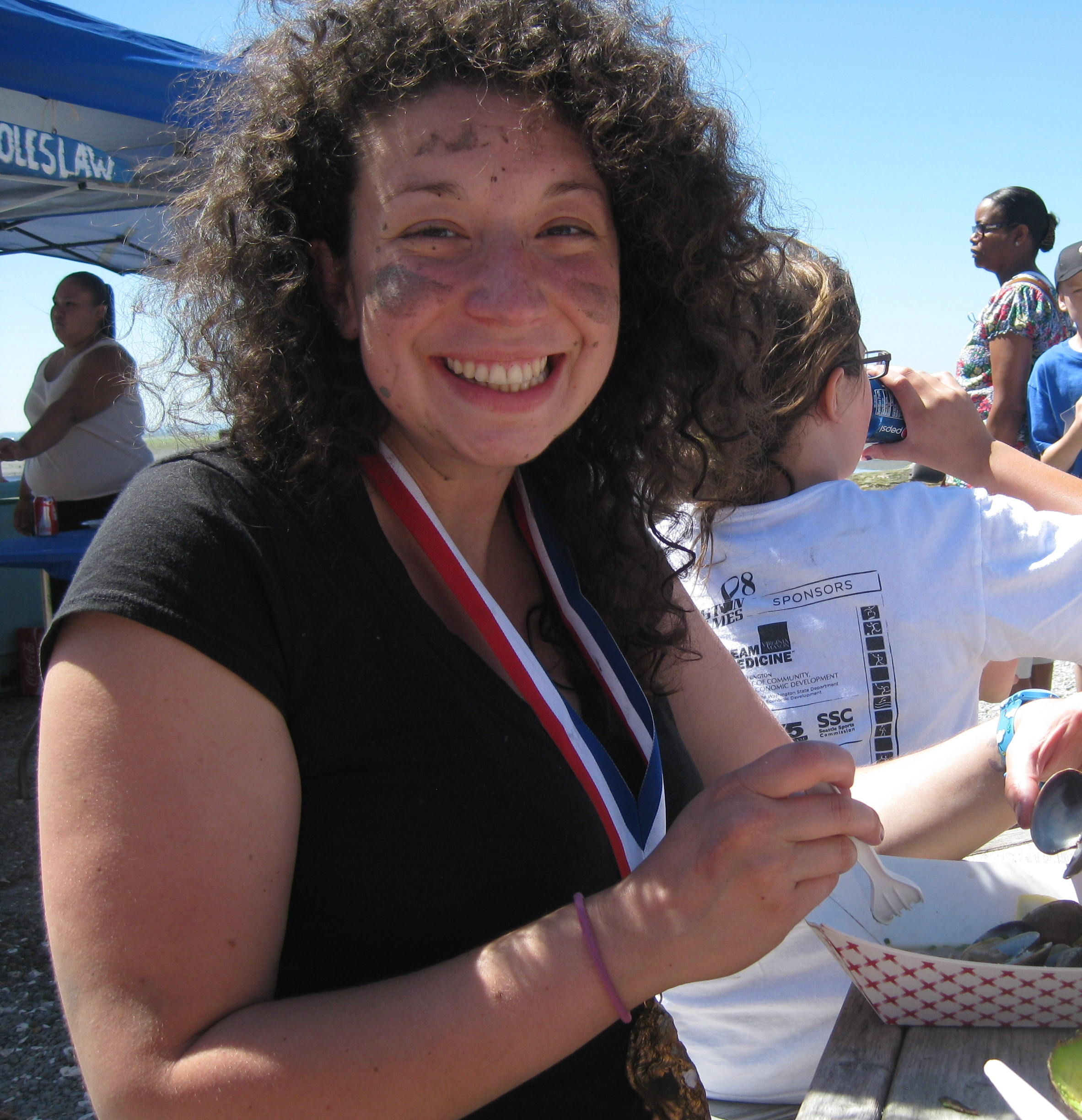
Roberts Lab
Notes:
I would also like to thank the Roberts lab, not only for being inspiring scientists, but also for being wonderful and fun people to spend a graduate career with.

Slide 101
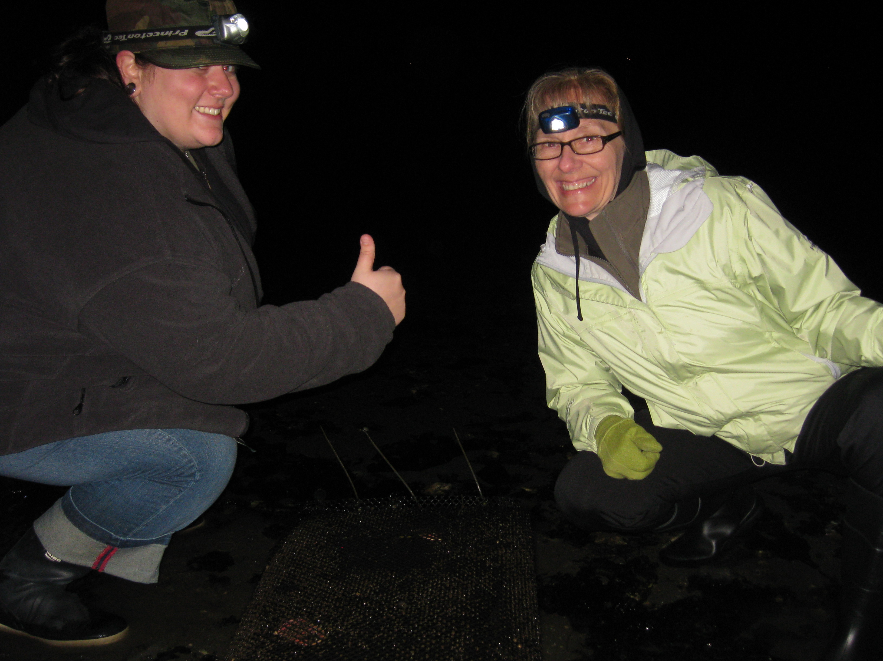
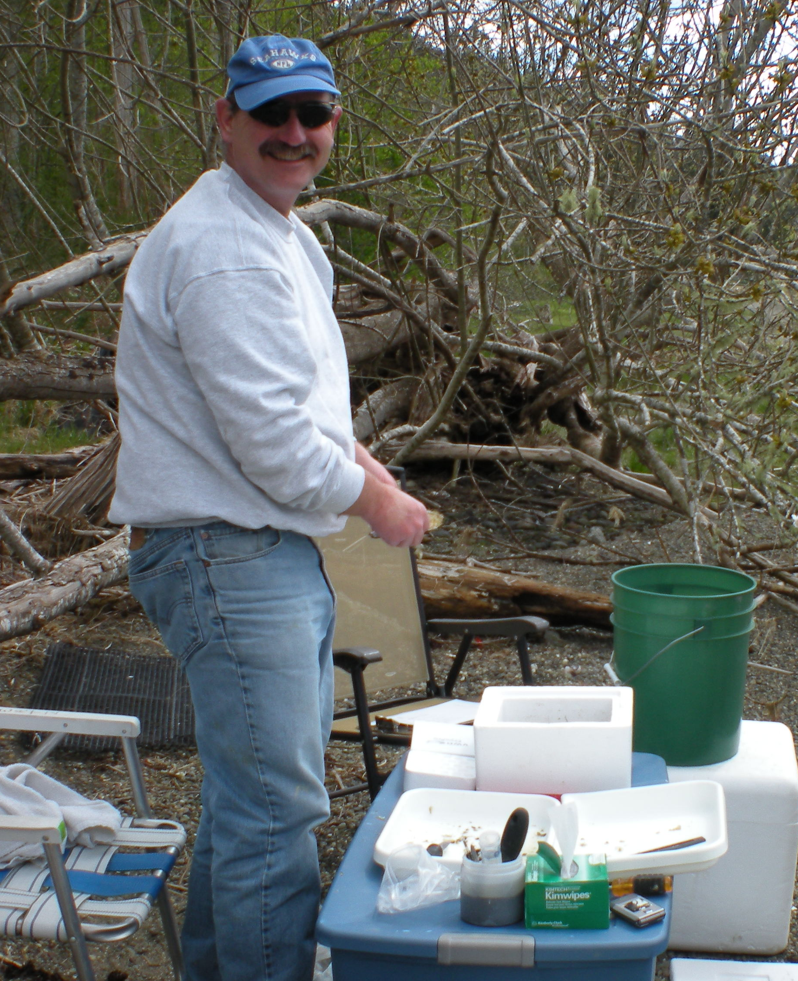
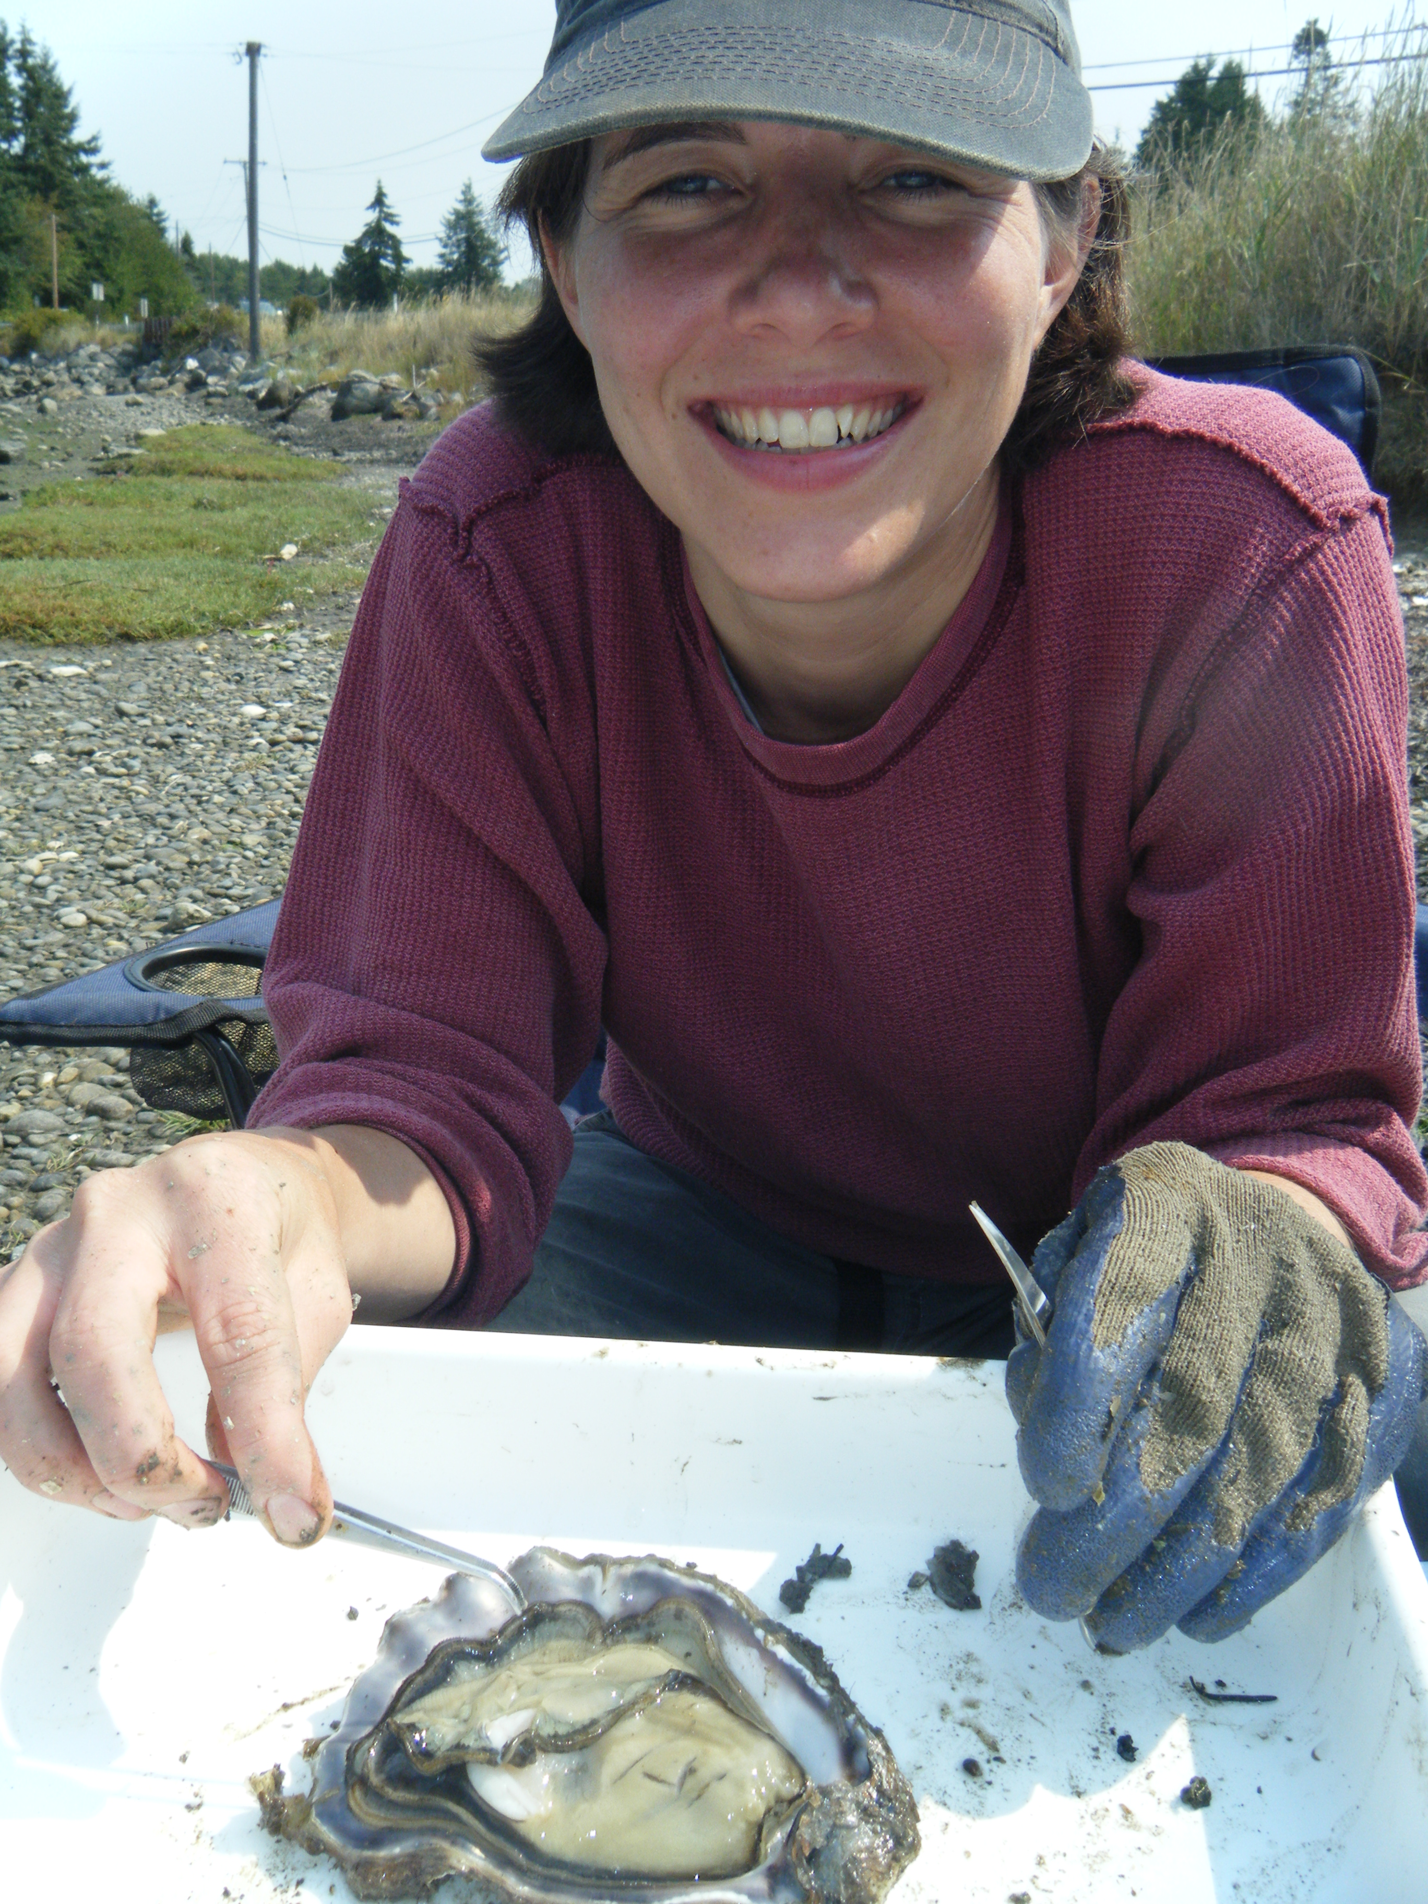
Family & Friends
Notes:
Finally, I would like to thank all of my friends and family for their overwhelming support and willingness to come tromp through the mudflats with me.
I would like to especially thank my favorite field crew, Lisa Crosson and my Mom who were always there with smiling faces to help sample oysters in the middle of the night
I would also like to thank my husband Brock for his never ending support and enthusiastic help in the field

Slide 102
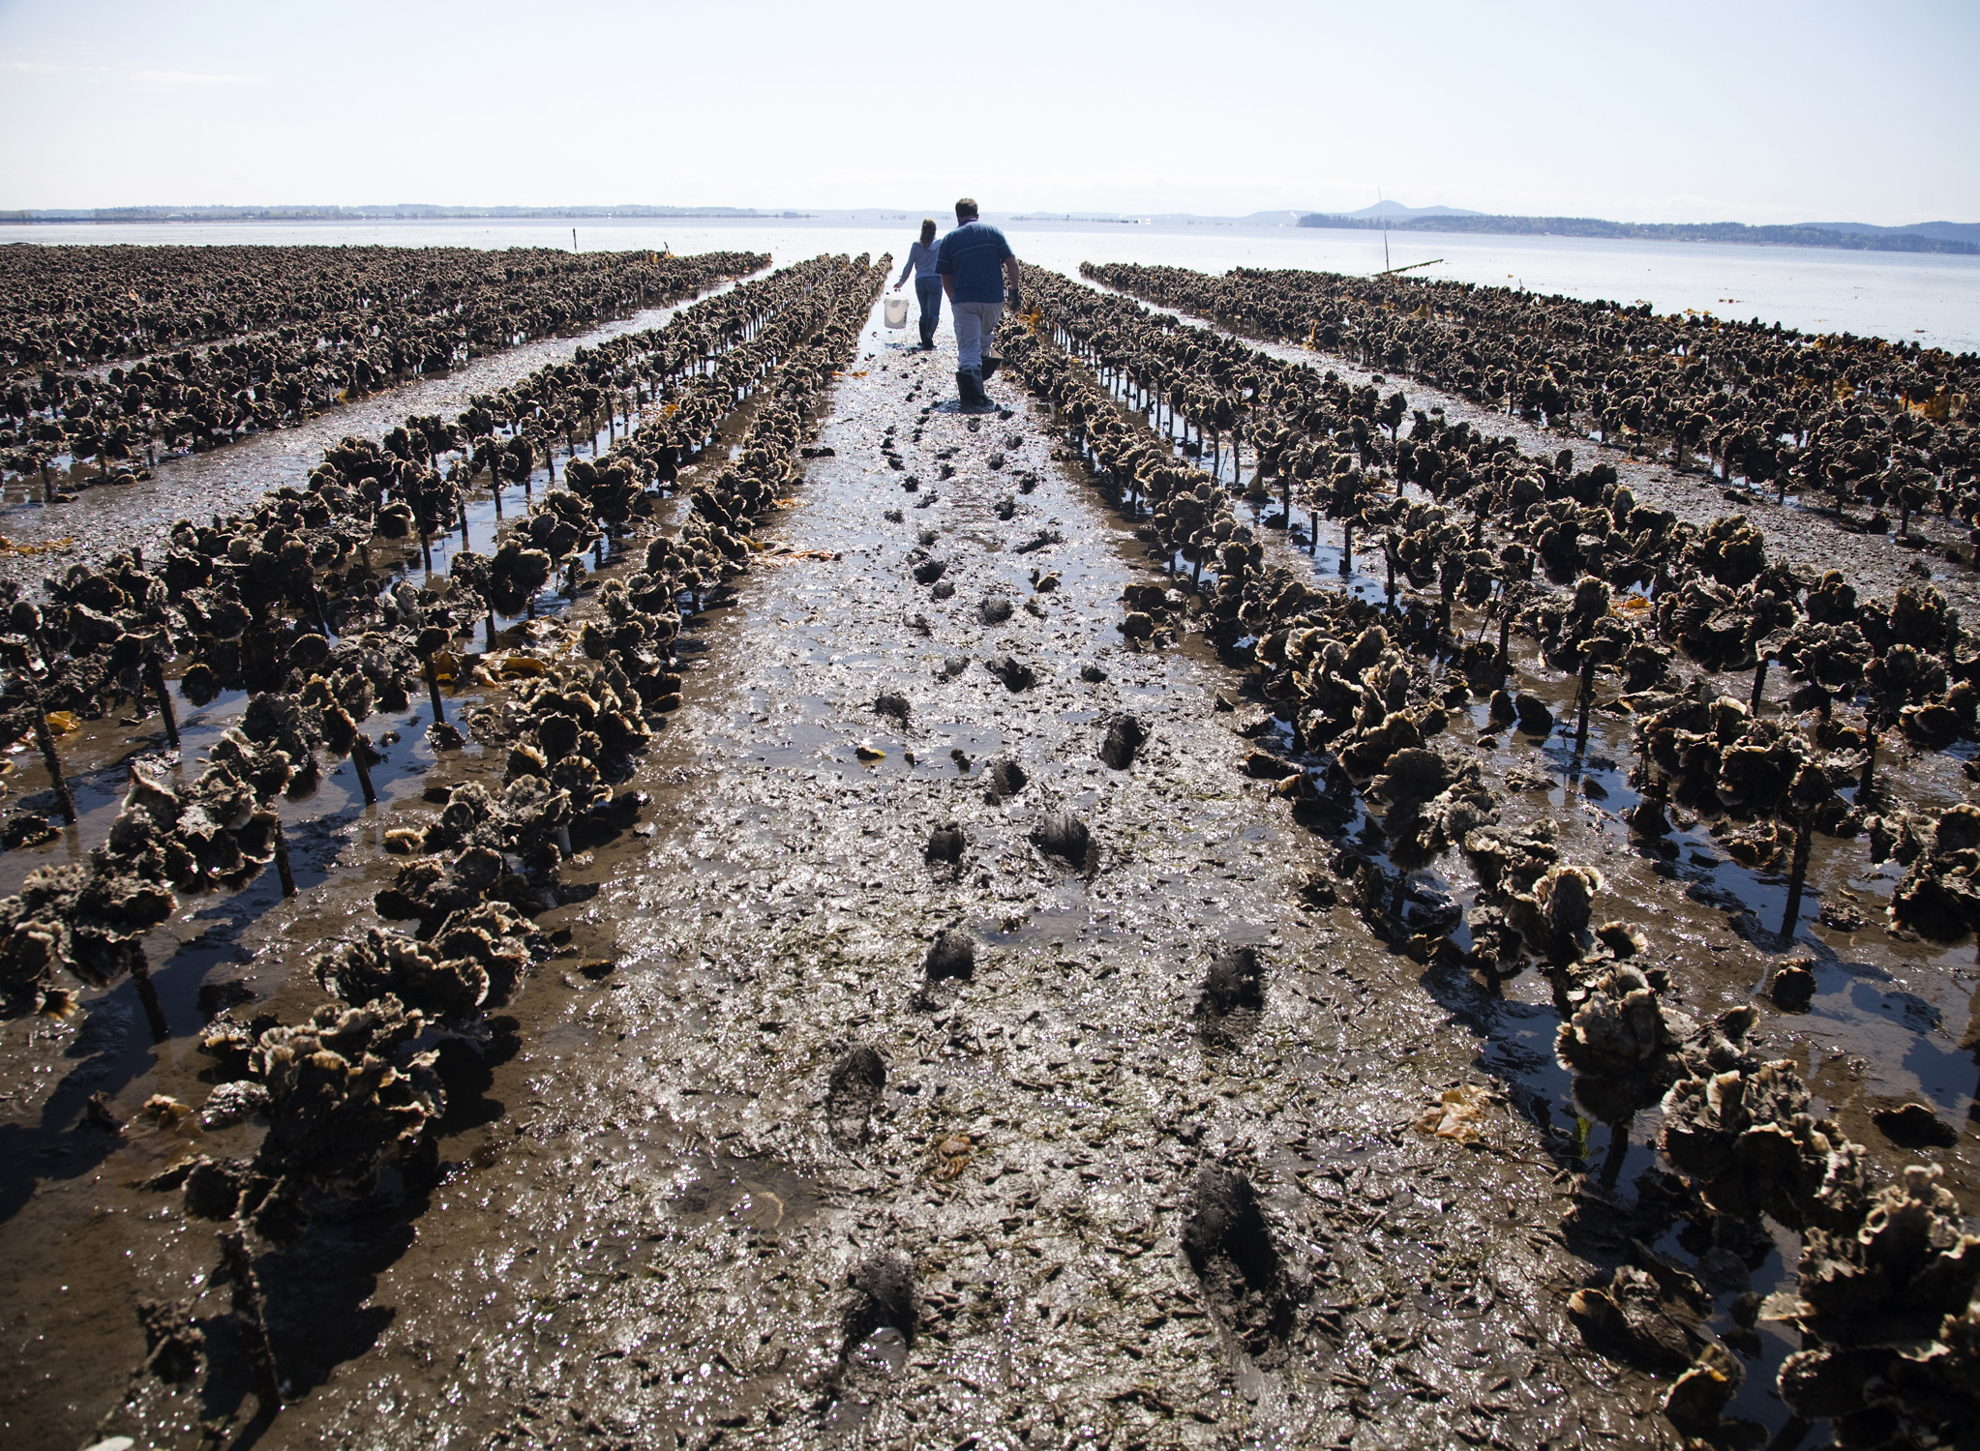
Questions?
Notes:
And with that I’d like to answer any questions you may have

